Slide 1
Malware Analysis
Dr. Tran The Son
Vietnam – Korea University

Slide 2

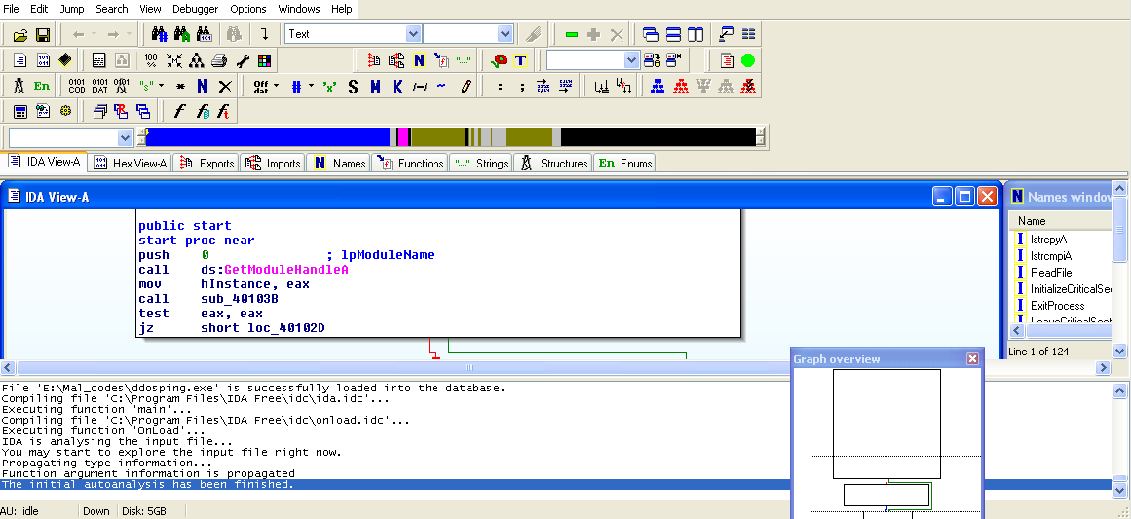
IDA Pro
Developed by Ilfak Guilfanov
    Russian, born 1966, the founder and CEO of Hex-Rays SA
Professional disassembler
Fast and interactive
IDA Pro Free and license
  Add comments, label data, name function ….
  Save to *.idb
  Plug-in

Slide 3
IDA Pro
Disassembly Windows
    Text – mode
    GUI with arrow (solid, dashed, facing up/down, …)
Other Windows
    Hex View
    Functions: all functions with length and flags (R, F, L, S, etc.)
    Names: every addresses with a name (functions, name coded, named data, strings)
    Strings: all strings
    Imports: all imports
    Exports: all exports
    Structures: layout of all active data structures
    Enums: all enumerated data type
Notes:
Option – General – Line Prefix – No. of Opcode bytes = 6
Option – General – Auto comments
R - function returns to the caller
F - far function
L - library function
S - static function
B - BP based frame. IDA will automatically convert
all frame pointer [BP+xxx] operands to stack
variables.
T - function has type information
= - Frame pointer is equal to the initial stack pointer
In this case the frame pointer points to the bottom of the frame
M - reserved
S - reserved
I - reserved
C - reserved
D - reserved
V - reserved

Slide 4
IDA Pro
Navigating
    Link: double-click
    Cross-reference: XREF
    Exploring history: ➔Forward/ ⬅ Backward buttons
    Navigation band: Light Blue/Red/Dark Blue
    Jump: address, name, function, etc.
Search
    Next Code
    Text
    Sequence of Bytes
    …..
Jump
    Name/Address/Function/Entry Point

Slide 5
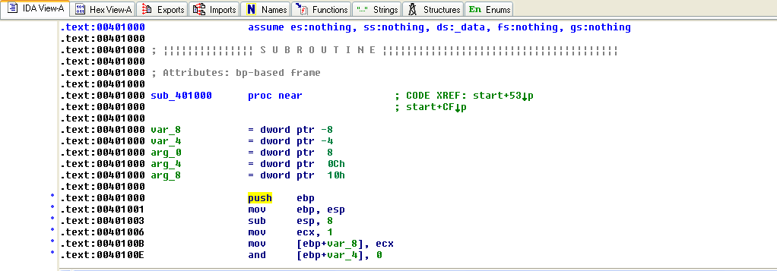
IDA Pro
Cross references - Xrefs
  Code Xrefs
  Data Xrefs
Analysing Functions

Slide 6
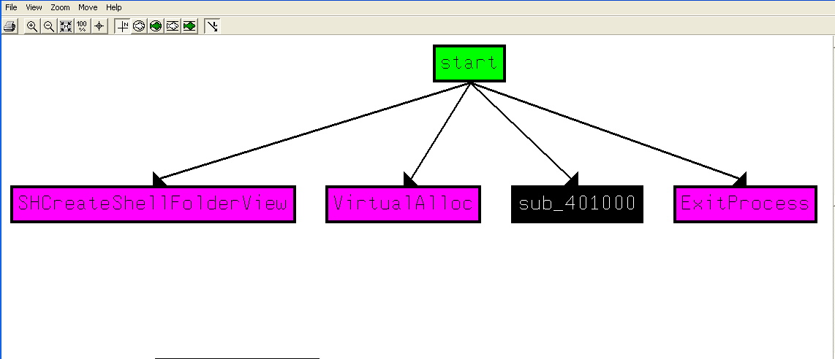
IDA Pro
Graph

Slide 7
IDA Pro
Patching
  IDA Pro allows to put comments, rename variables, etc.
    Rename functions
    Rename variables
    Comments
    Format operands: hex, dec, etc.
    Using Name constant:
    Redefining code and data

Slide 8
IDA Pro
Plug-in
  IDC script
  Python script

Slide 9
Practice 01
Write “Hello World” in C
Compile and Examine it in IDA Pro

Slide 10
Practice 02
Write a piece of code for deleting a file with argument “-r”
Compile and Examine it in IDA Pro

Slide 11
Practice 03
Download and examine by IDA Pro to find the password
  Exer0_Password.exe
  Exer1_GoodLuck.exe
https://www.begin.re/playground-exercises

Slide 12
Practice 04
Download and examine Lab05-01.dll
  1. What is the address of DllMain?
  2. Use the Imports window to browse to gethostbyname. Where is the import located?
  3. How many functions call gethostbyname?
  4. Focusing on the call to gethostbyname located at 0x10001757, can you figure out which DNS request will be made?
  5. How many local variables has IDA Pro recognized for the subroutine at
  0x10001656?
  6. How many parameters has IDA Pro recognized for the subroutine at
  0x10001656?
  7. Use the Strings window to locate the string \cmd.exe /c in the disassembly.
  Where is it located?
  8. What is happening in the area of code that references \cmd.exe /c?

Slide 13
Practice 05
Download
  Exer2_Julia.zip (password: CLEAN)
https://www.begin.re/playground-exercises

